Slide 1
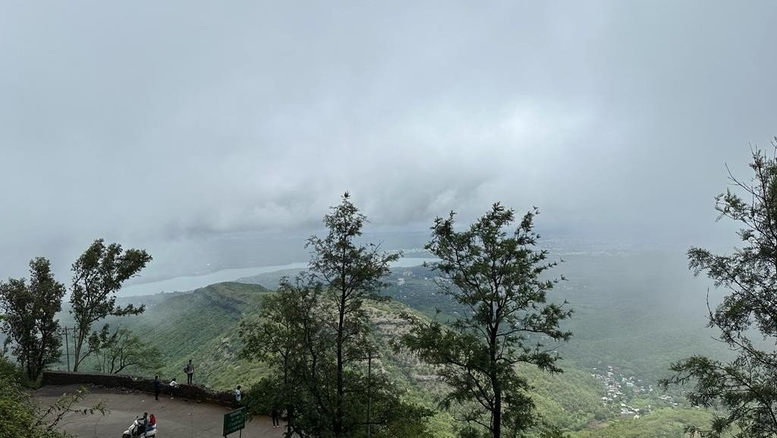
Sinhagad Fort: Uncovering the History and Legends Surrounding its Walls

Slide 2
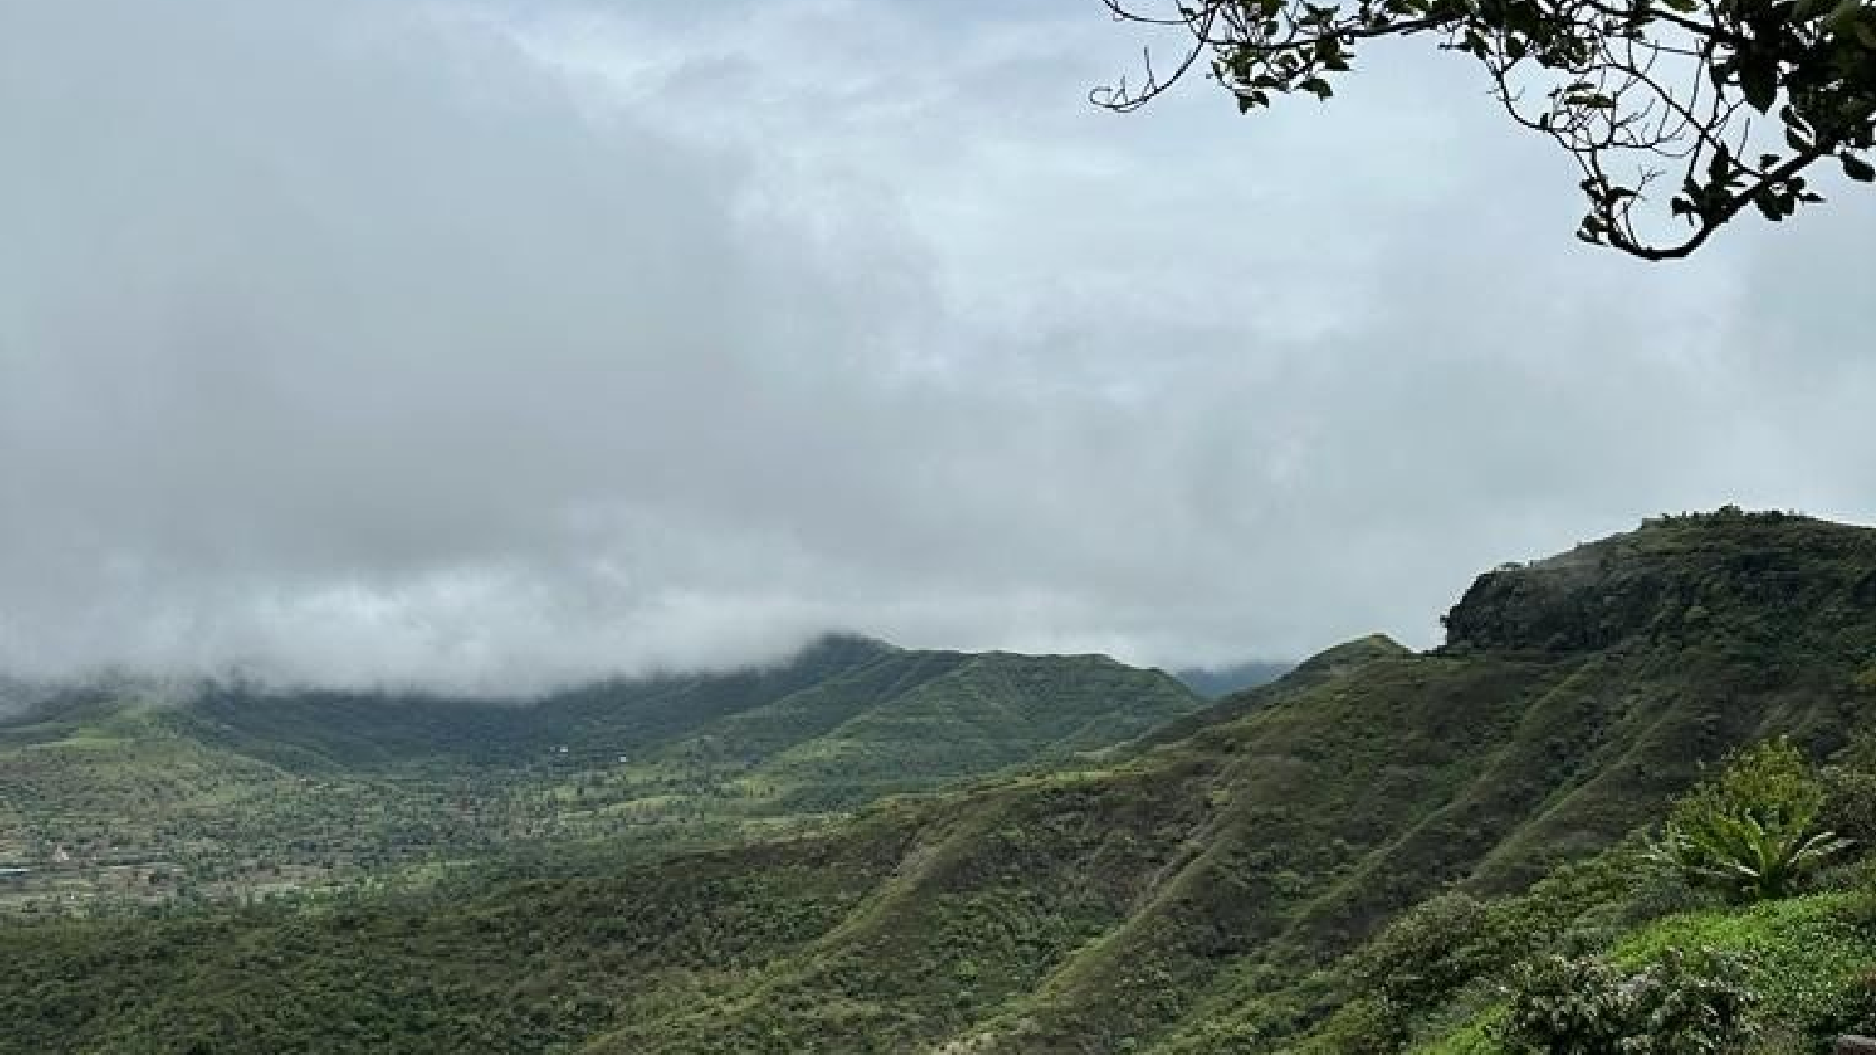
Introduction
Sinhagad Fort is a historical fortress located on an isolated hill in the Western Ghats. It has been witness to several important battles and is known for its strategic location and natural beauty.

Slide 3
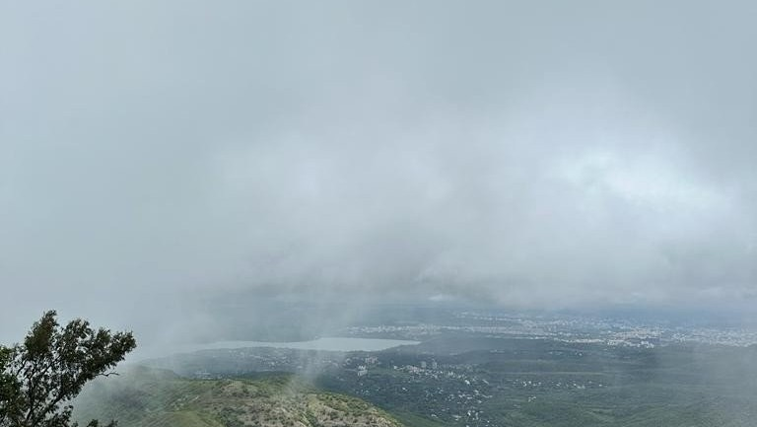
History
The fort was originally called Kondhana and was built by the Bahmani Sultanate to keep a watch on the surrounding areas. It was later captured by Shivaji Maharaj in 1670 and played a signiﬁcant role in the Maratha Empire's history.

Slide 4
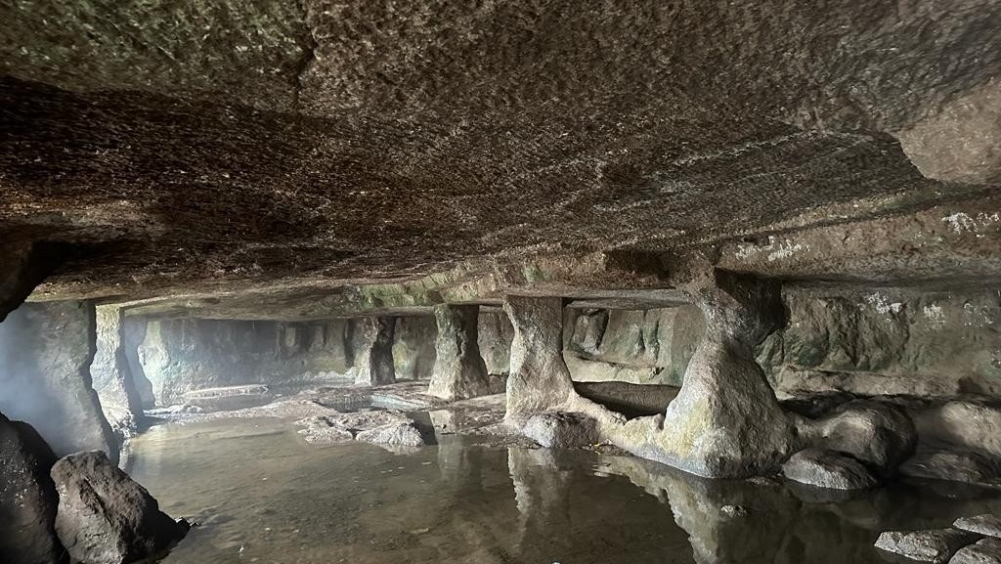

Architecture

Slide 5
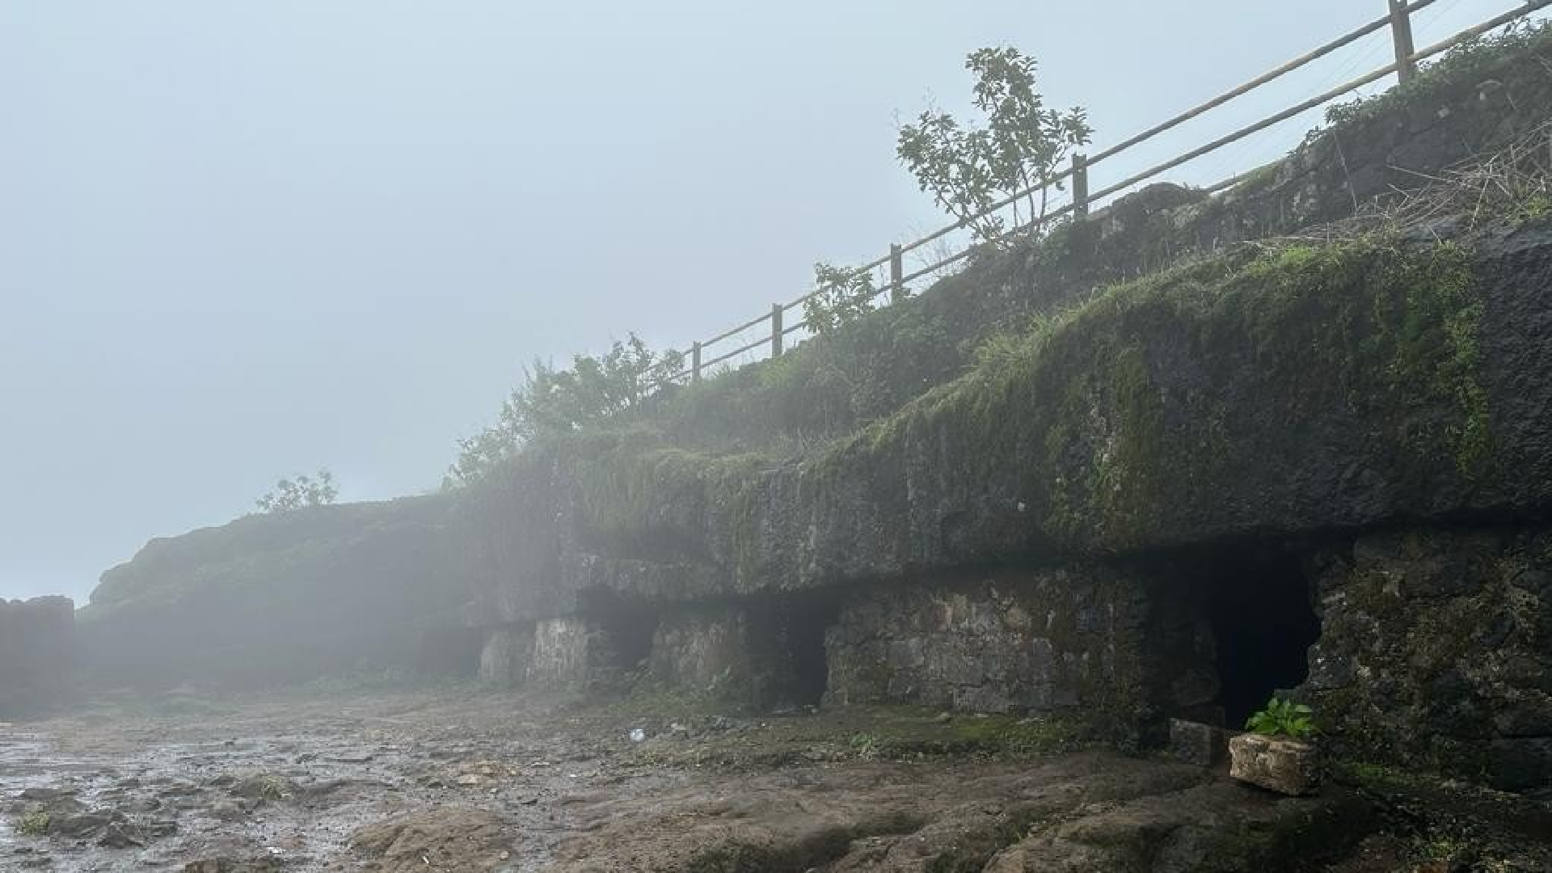
Legends
The fort is surrounded by several interesting legends. One of them is the story of Tanaji Malusare, who sacriﬁced his life to capture the fort for Shivaji Maharaj.

Slide 6
Tourism
The fort is a popular tourist destination and attracts visitors
from all over the world. Visitors can enjoy trekking, hiking, and camping in the surrounding hills.
The fort also has several food stalls that serve local delicacies.

Slide 7
Conclusion
Sinhagad Fort is a testament to India's rich history and culture. Its architecture, legends, and natural beauty make it a must-visit destination for history buffs and nature lovers alike.

Slide 8
Thanks!
PC 23 Devanshu Surana
PC 26 Pranav Pisal
PC 30 Abhilash Kashid
PC 32 Prachiti Kulkarni

